Slide 1
TechiNar Series
Unit Testing Frameworks
May 20th, 2014
By Ayaz Lakdawala

Slide 2


Slide 3
Agenda
Differences between JUnit 3.x and JUnit 4.x
New Features provided by JUnit 4
Spock Testing Framework
Upcoming Hot TechiNarS
3rd Party Libraries
Credits
Demo
References
Q and A

Slide 4

DIFFERENCES

Slide 5



No need to extend TestCase class
JUnit 3.x Junit 4.x
Flexibility to have custom test method names.
JUnit 3.x Junit 4.x

Slide 6
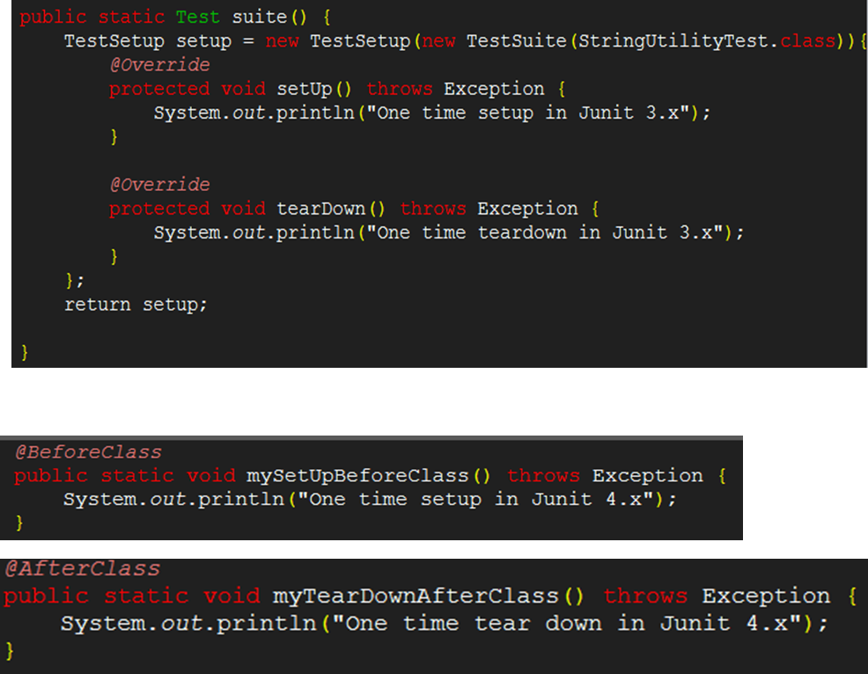
Differences (Contd..)
One Time setup and tear down:
JUnit 3.x
JUnit 4.x

Slide 7
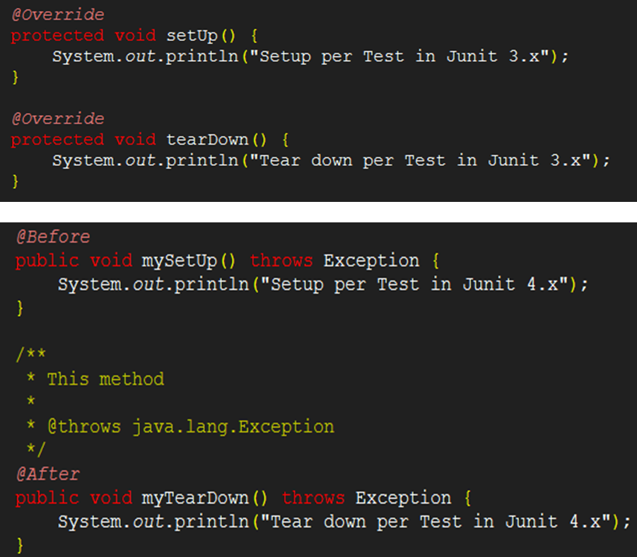
Differences (Contd..)
SetUp and TearDown per test:
JUnit 3.x
JUnit 4.x

Slide 8


Differences (Contd..)
Assert Statements:
JUnit 3.x
Functionality provided by base-class (junit.framework.Assert) of TestCase class.
JUnit 4.x
Provides additional functionality to asset arrays.(assertArrayEquals)
Specific asset statements can be imported statically.
Notes:
Assert Statements:
Junit 3.x uses inherited assert Methods of TestCase class
Junit 4.x uses statically imported assert Methods from Assert class directly.
Ignoring tests
No direct way to ignore tests in Junit 3.x except for renaming the tests.

Slide 9
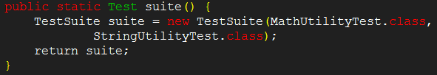

Differences (Contd..)
Test Suite:
JUnit 3.x
JUnit 4.x
Notes:
Test Suite:
Junit 3.x uses TestSuite class.
Junit 4.x uses Suite Runner and @SuiteClasses annotation.

Slide 10
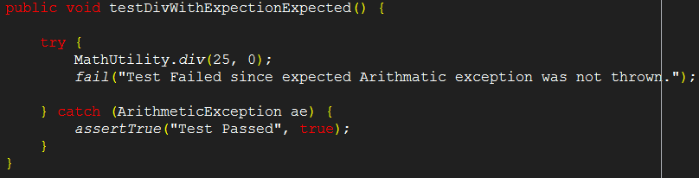

Differences (Contd..)
Testing Exceptions:
JUnit 3.x
JUnit 4.x
Notes:
Testing Exceptions:
Junit 3.x uses try-catch.
Junit 4.x uses expected attribute of @Test annotation.

Slide 11
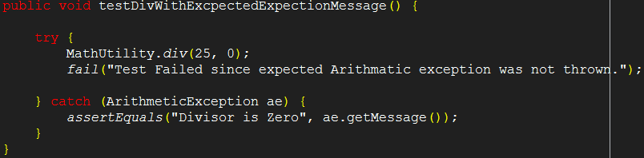
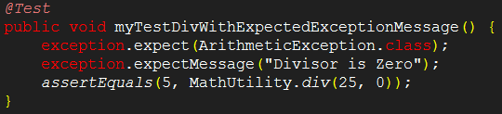
Differences (Contd..)
Testing Exceptions with messages:
JUnit 3.x
JUnit 4.x
Notes:
Testing Exceptions with messages:
Junit 3.x uses try-catch.
Junit 4.x uses @Rule annotation.

Slide 12

NEW FEATURES BY JUnit 4

Slide 13
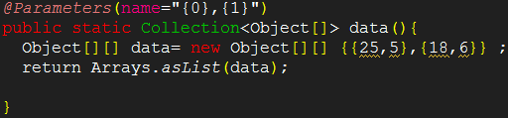

Parameterized Testing with Parameterized Runner :

Slide 14

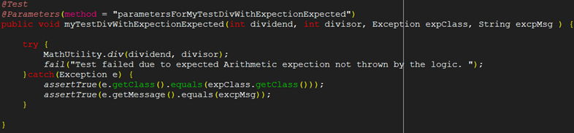
New Features (Contd..)
Parameterized Testing with JunitParamsRunner :

Slide 15

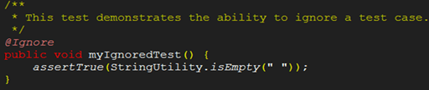
New Features (Contd..)
Spring JUnit Testing:
Ignoring tests

Slide 16
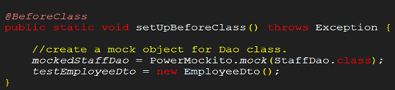
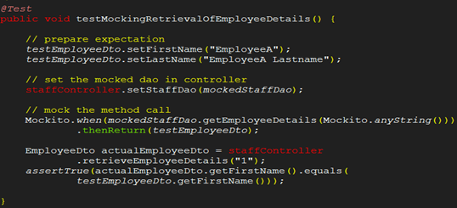
New Features (Contd..)
Mocking using
PowerMockito:

Slide 17
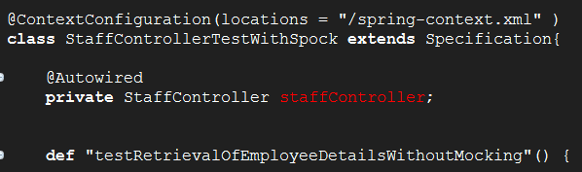
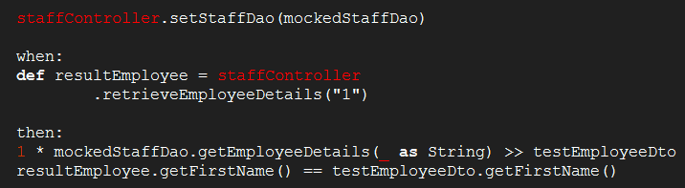
Spock Testing Framework
Mocking using
Spock Framework:

Slide 18
Upcoming Hot Techinars
GitHub
Git
MongoDB
Hadoop
Pig Latin
Vagrant
Docker
NodeJS

Slide 19
3rd Party Libraries:
Junit 4 → Ver: 4.11 Jar: junit-4.11.jar
Spring Framework → Ver: 4.1.0.BUILD-SNAPSHOT
spring-test
spring-context
Spring-core
Power Mock → Ver: 1.5.5 License: Apache License 2.0
powermock-module-junit4
powermock-api-mockito
powermock-module-junit4-rule-agent
Spock Framework → Ver: 0.7-groovy-2.0 License: Apache License 2.0
spock-core
spock-spring
Cglib-nodep → Ver: 2.2.2 License: Free S/w.
Junit Params → Ver 1.0.2 License: Apache License 2.0

Slide 20


Slide 21
Junit Topic suggestion: Prakash Krishnamurthy
Spock Framework Topic suggestion: Jiji James

Slide 22


Slide 23


Slide 24

References

Slide 25
References
Kushal. (April 26, 2014) “10 Differences Between JUnit 3.x and JUnit 4.x and why you should move to JUnit 4.x platform”[Blog Post]. Retrieved from http://www.sanjaal.com/java/981/java-unit-testing-and-junit/10-differences-between-junit-3-x-and-junit-4-x-and-why-you-should-move-to-junit-4-x-platform/.
Vogel, Lars. (October 28, 2013) “Unit Testing with JUnit – Tutorial”[Website]. Retrieved from http://www.vogella.com/tutorials/JUnit/article.html.
Johnson,R. , Hoeller, J. , Donald K. , Sampaleanu C. , Harrop, R. , Thomas Risberg, T. , Arendsen, A., . . . Deleuze S.(2014) “Spring Framework Reference Documentation”. Retrieved from http://docs.spring.io/spring/docs/4.1.0.BUILD-SNAPSHOT/spring-framework-reference/htmlsingle/.
Johan, Jan (2014) “Power Mock”[Google Project Hosting]. Retrieved from https://code.google.com/p/powermock/
Peter Niederwieser (2012) “Spock Framework Reference Documentation”[Google Project Hosting]. Retrieved from https://code.google.com/p/spock/

Slide 26


